Slide 1
TENDER MANAGEMENT SYSTEM

Slide 2

TEAM DETAILS
Team Lead:
Swaythana Rajendraprasad
Team Members:
Abilash Jeeva
DhineshKumar Marimuthu
Mohana Priya Raju
PungaLingam Ramasamy

Slide 3
ABSTRACT
The tender management system is a project which is developed to enable the contractor to get all the tender details online and provide facility to submit the tender.
This Tender Management project provides a system which will reduce the extra cost which involves for this entire process like advertising, document processing and getting confirmation results.
By using this Tender Management application contractor can save a lot of time in making the documents online, sending and receiving documents using the postal system.

Slide 4
Objective
•This is a plan to make tender publishing online.
•As a part of it, tender data is recorded along with particulars of the products, their specifications and conditions.
•Tenders published will be visible to the visitors of the site till the closing date of tender.
So we make this whole process of tendering online which is efficient and consumes very less time

Slide 5
Modules
•Admin
•Contractor
•User

Slide 6
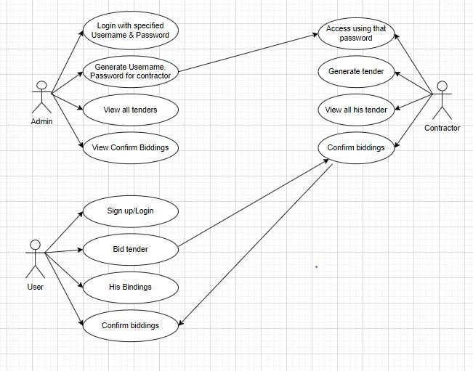
Use case diagram

Slide 7
Proposed Methodology
•In the proposed system all the activity will happen through the software which will be a web-based system.
•The user can get the available tender by accessing through the system.
•If new user is registering they need to sign up to access the system, they need to login with the system , and then admin will provide with a user Id and password.

Slide 8
Software Requirements
● Build Tool - Maven
● Java 1.8
● Server - Tomcat
● Spring Tool Suite
● Back-End - MySql database
● Front-End - JSP(used for creating dynamic web pages)

Slide 9
Functionalities of module
Admin | Contractor | User
Login Register Contractor View Tenders Confirm Biddings Logout | Generate tender View all tenders All biddings Confirm bidding. Logout | View all tenders Register tender My biddings Confirm Biddings Logout

Slide 10
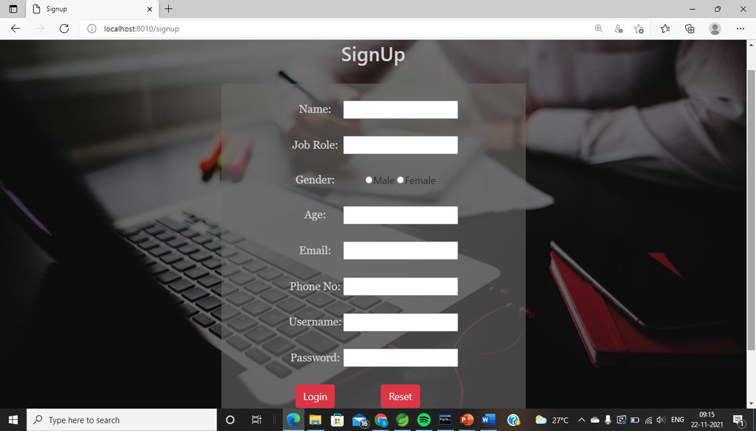
New user signup :

Slide 11
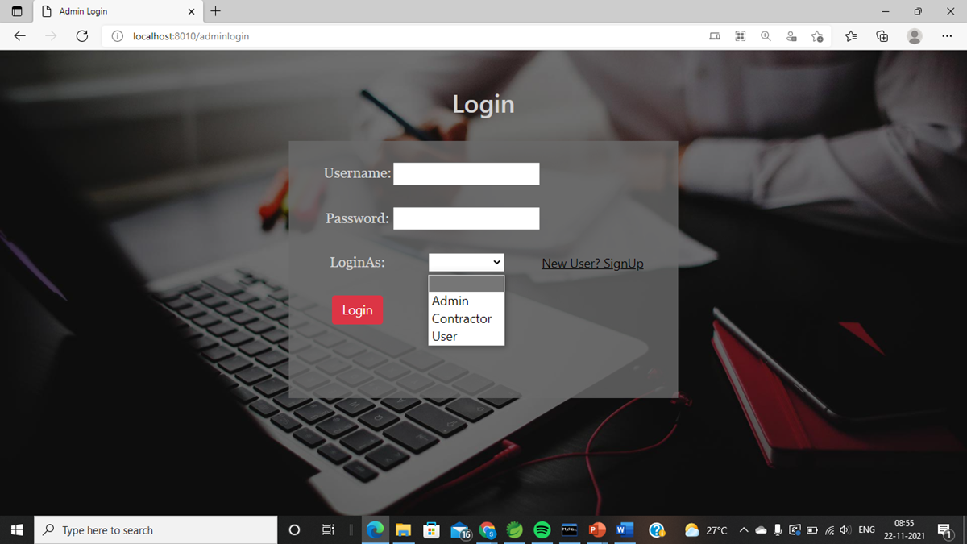
Login Page

Slide 12
Admin Module
•Login
•Register Contractor
•View Tenders
•Confirm Biddings
•Logout

Slide 13
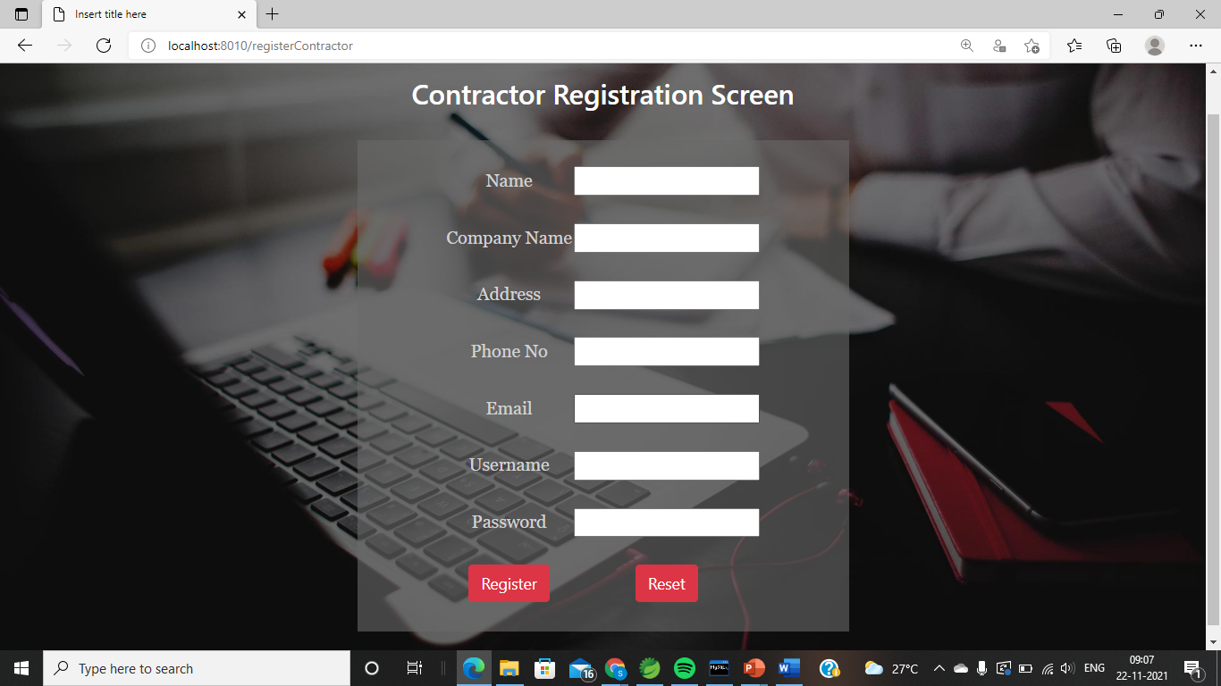

Register Contractor

Slide 14
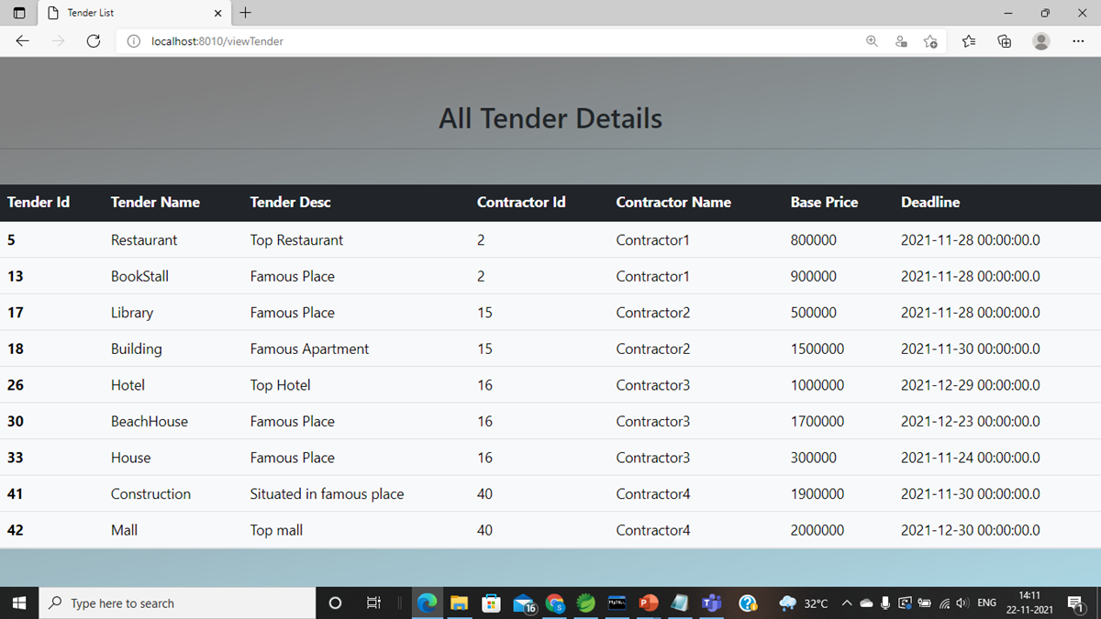
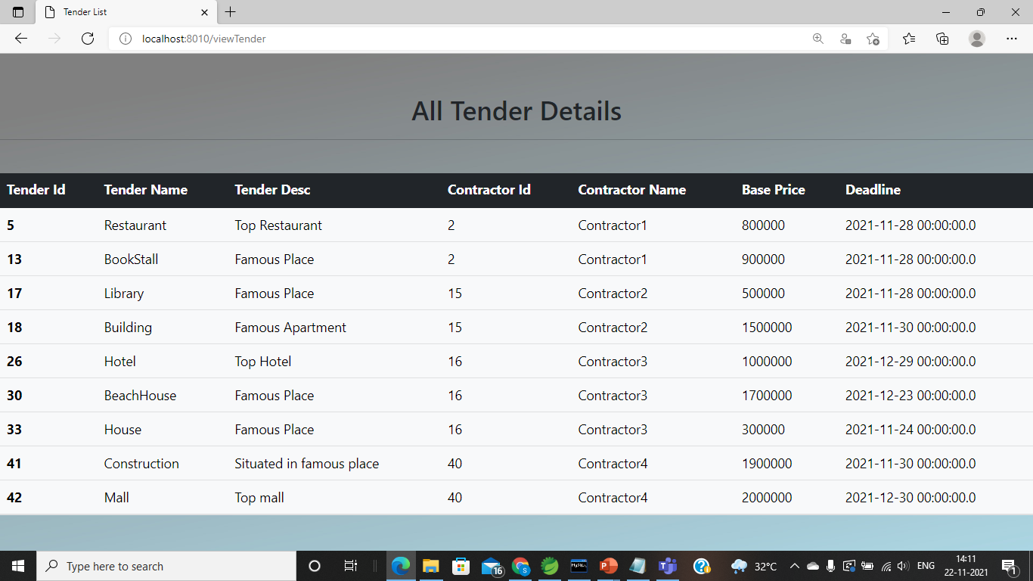
View Tenders

Slide 15
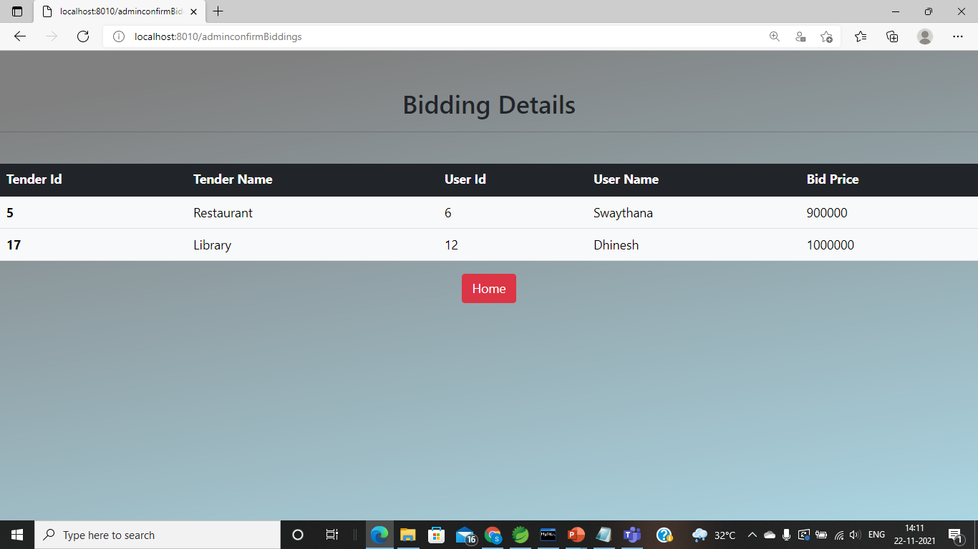

Confirm Biddings

Slide 16
Contractor Module
•Generate tender.
•View all tenders.
•All biddings.
•Confirm biddings.
•Logout

Slide 17
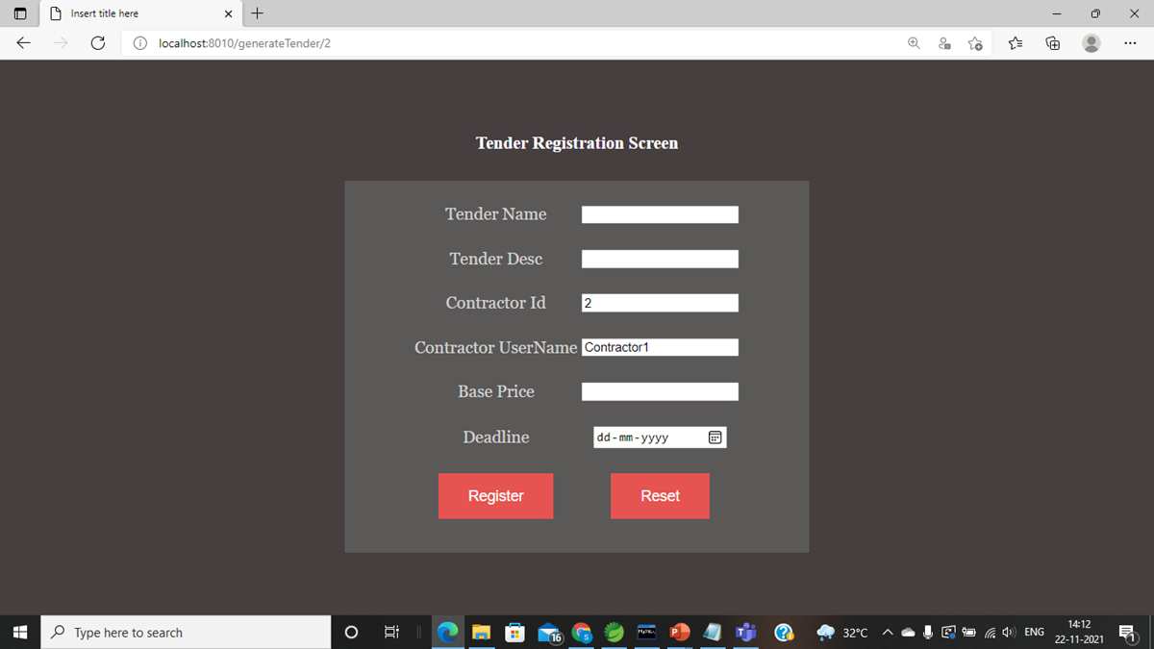
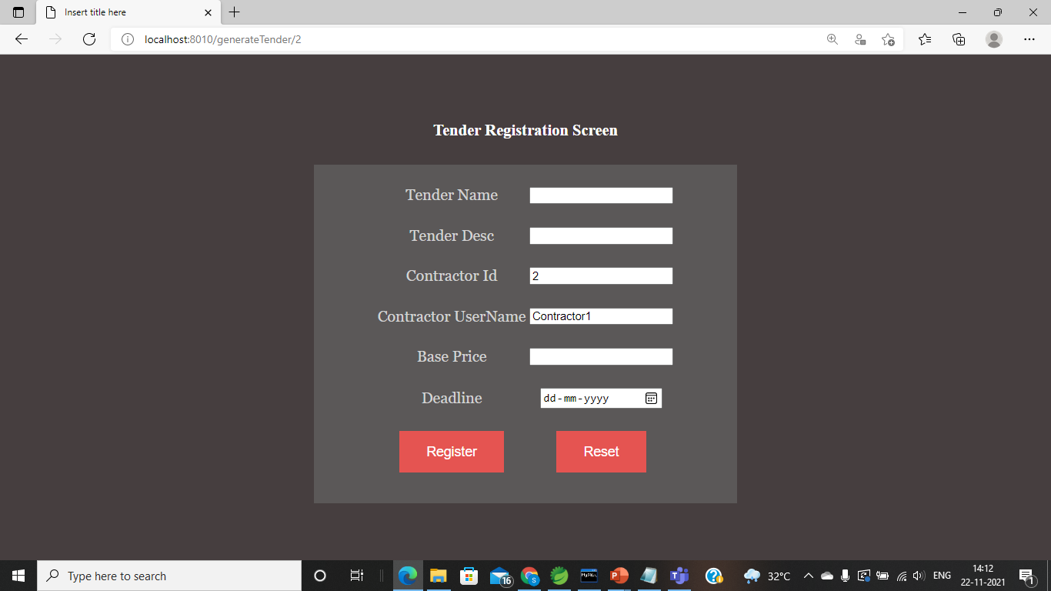
Register Tender

Slide 18
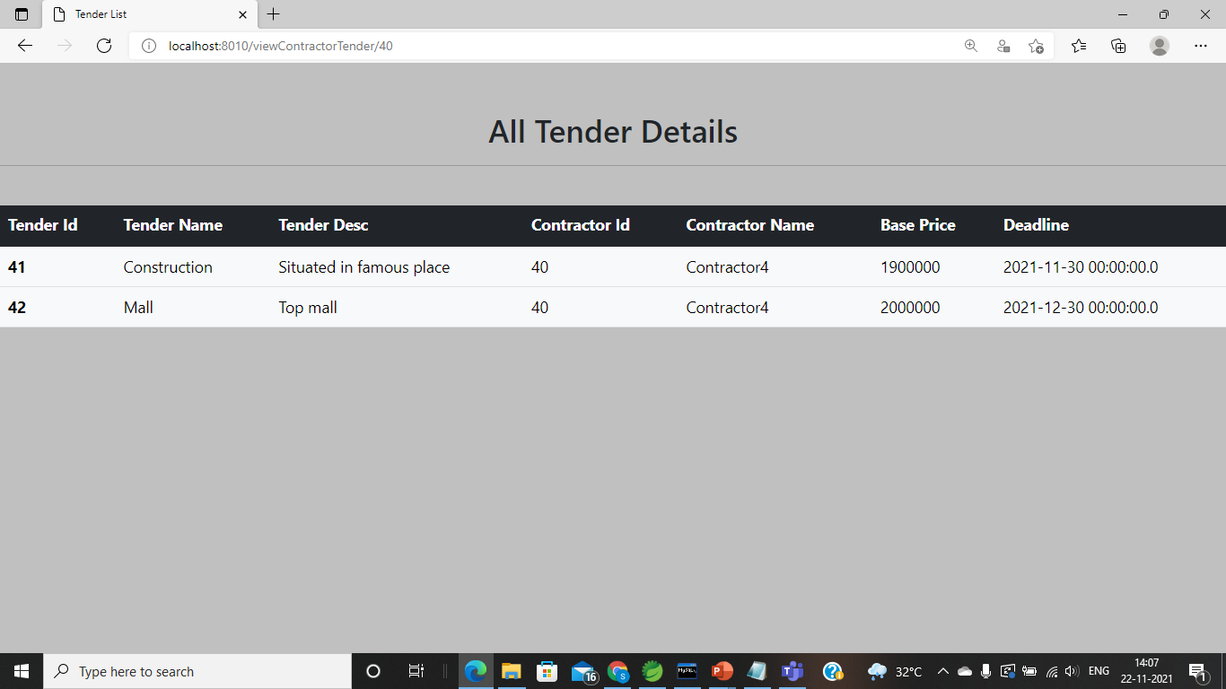

View All Tenders

Slide 19
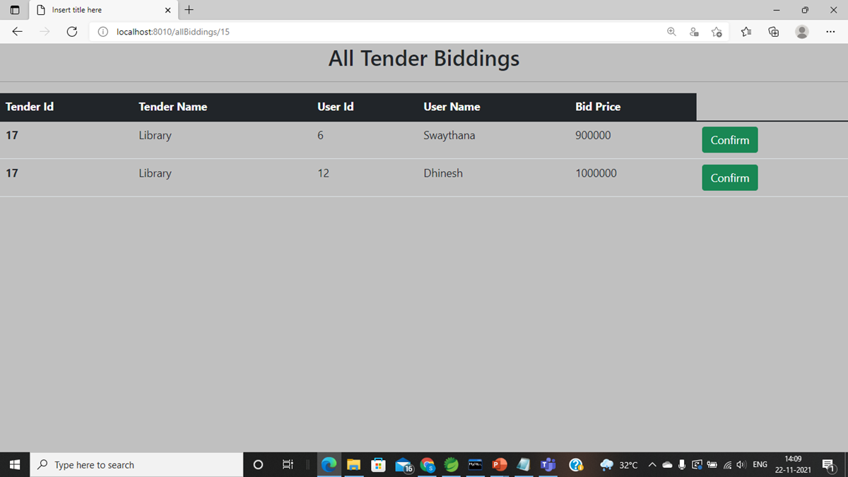
Confirm Biddings

Slide 20
User Module
•View all tenders
•Register tender
•My biddings
•Confirm Biddings
•Logout

Slide 21
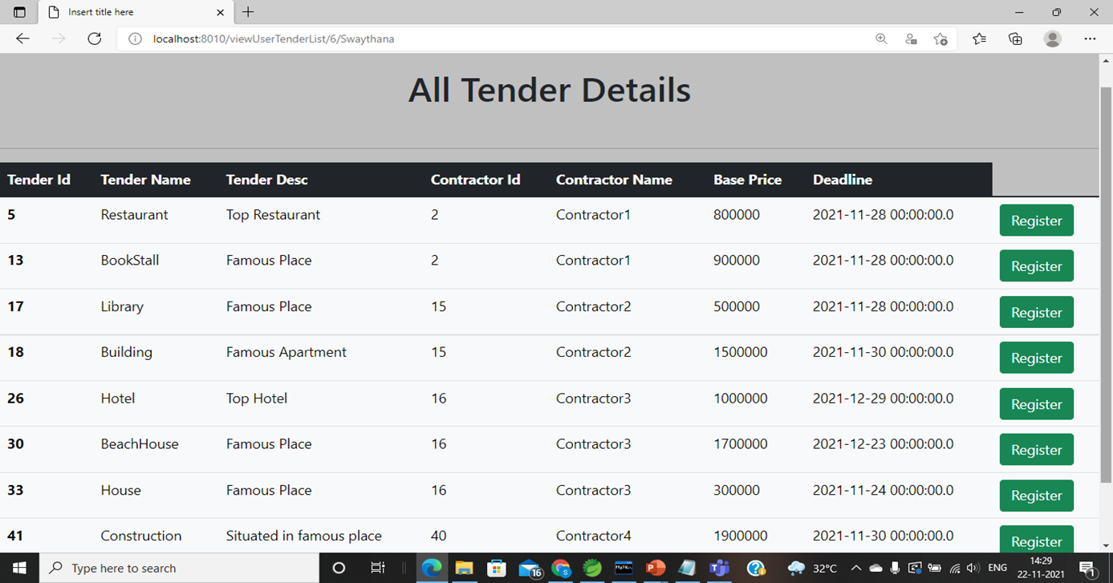
View and Register tender

Slide 22
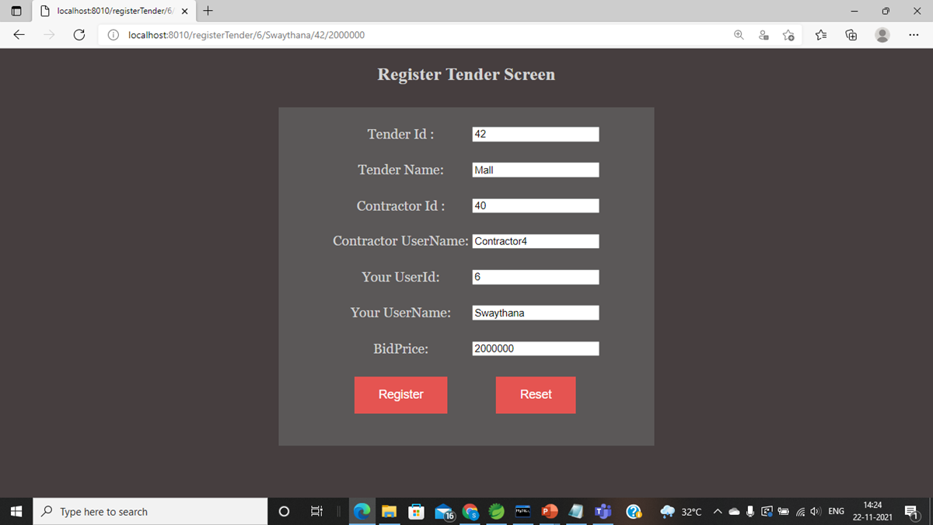
Register tender

Slide 23
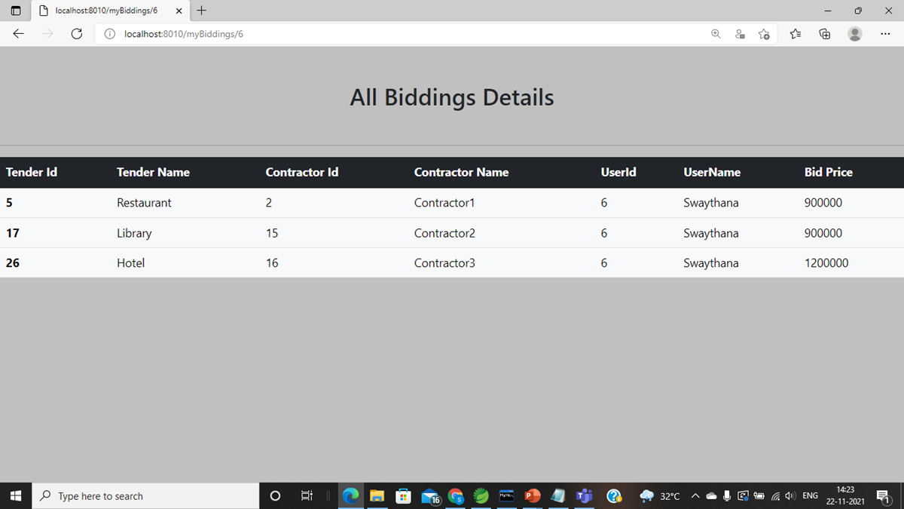
My Biddings

Slide 24
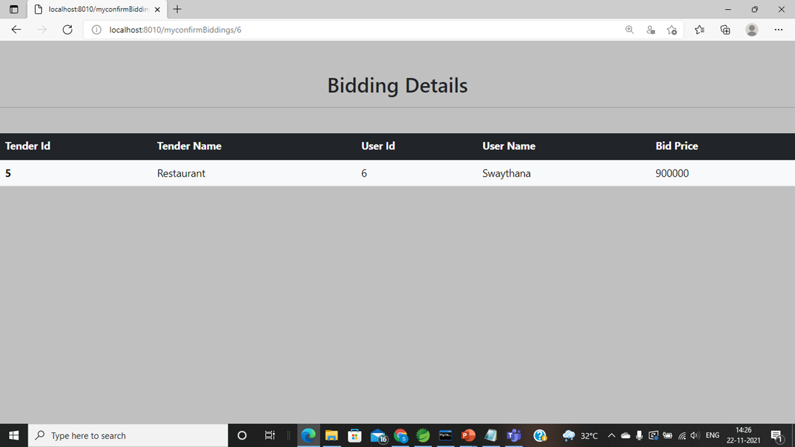
Confirm Biddings

Slide 25
Conclusion:
Our project tender management system has successfully created a user friendly environment in tender management process. our project is flexible and changes can be incorporated easily. It is so designed that further modifications to the system can be easily done.

Slide 26
FUTURE WORK
•Search the Tender by using the Tender ID , Tender Name
•Update the Profile for Contractor and User Modules
•To add the payment gateway for the user to finalise the tender
•To add the forget password method in login page
•To close the tender at the given time

Slide 27

THANK YOU

